Slide 1

AI-Generated Text Detection

Slide 2
Contents
Problem Statement
Objective
Purpose
Data Source
Dataset
Model Architecture
Model Training
Model Evaluation and Results

Slide 3

Problem Statement:
The evolving era of generative AI has led to the advancement of LLM and now it is a new challenge to differentiate LLM and AI-generated content.
This project aims to prevent the user trust and minimize safety concerns, reputational and Legal Risks
The lack of a dedicated solution for the detection and moderation of LLM-generated text hampers the ability of organizations to maintain a secure and compliant online environment, thereby necessitating the development and implementation of a specialized system for the identification and management of LLM-generated content.

Slide 4
Objective:
Developing a robust AI Model capable of detecting and analyzing the text generated by various AI applications.
Designing the AI Model that is highly precise and reliable in text detection, by minimizing the False Positive rate.
Enabling the real-time detection of AI-generated text, facilitating the quick and timely identification of AI-generated text across any platform.

Slide 5
PURPOSE
The rise of AI-generated misinformation underscores the urgent need for advanced detection algorithms that can differentiate between human and machine-generated content.
Collaborative efforts between technology developers, researchers, and platforms are essential to stay ahead of evolving threats and safeguard the integrity of online information.

Slide 6

Data Source:
What is Kaggle?
Kaggle is a popular online platform for Data Science competitions, Machine Learning challenges, and collaborative data analysis.
Data for this project is sourced from Kaggle Competitions.
Further AI-generated text ChatGPT, BARD, Microsoft Bing, etc. Generative AI technologies as used.

Slide 7
DATASET:
The Dataset used consists of positive and negative classes with total count of 2784 with a ratio of around 1:1.
Negative Date [0]: Represents the collection of approx. 1430 essays written by students
Positive Data [1]: Represents the Essays generated by ChatGPT, BARD, Microsoft Bing, etc. The count of AI-generated essays is 1354.

Slide 8
Why LSTM?
Sequential data handling power
Memory Retention of LSTM
Avoids vanishing Gradient Problem
Gating Mechanism

Slide 9
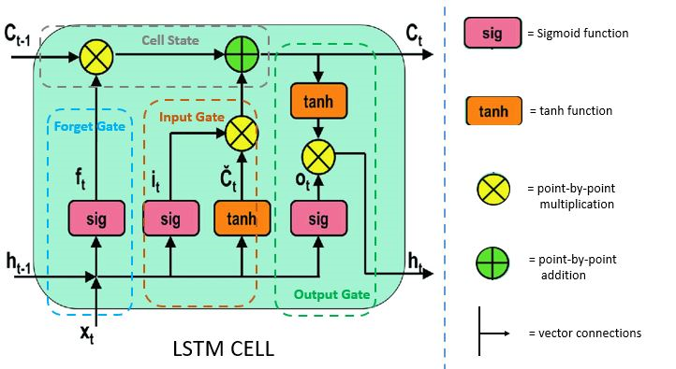
Model Architecture - LSTM
LSTM has FOUR important components that make it very useful while working on sequential data or identifying patterns.
1. Memory Cells
2. Gates
3. Cell State
4. Backpropagation Through Time

Slide 10
Model Architecture - LSTM
This Classification model consists of 5 Layers in total as described.
1. Embedding Layer as Input Layer with required input dimensions and shape as per the data.
2. Hidden layer has 3 layers in total:
Layer-1 : LSTM with 120 neurons and normalized by using dropouts.
Layer-2 : LSTM with 60 neurons and normalized by using dropouts.
Layer-3 : LSTM with 30 neurons and normalized by using dropouts.
3. Output Layer : Dense with 1 output neuron and Activation function is 'Sigmoid'

Slide 11
Model Training:
Model training is done using 3 criterias:
1. Optimizer : 'Adam’
2. Loss Function : 'Binary Crossentropy’
3. Metrics : 'Accuracy'

Slide 12
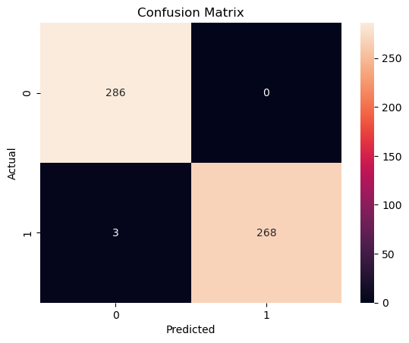
Model Evaluation and Results
Classification Accuracy: 99.5 %
Classification Error: 0.5 %
False Positive Rate: 0.0
Precision: 1.0
AUC Score: 0.995

